Slide 1
PRNGs and Diffie-Hellman Key Exchange

Slide 2
Last Time: Hashes
Map arbitrary-length input to fixed-length output
Output is deterministic and unpredictable
Security properties
One way: Given an output y, it is infeasible to find any input x such that H(x) = y.
Collision resistant: It is infeasible to find another any pair of inputs x' ≠ x such that H(x) = H(x').
Some hashes are vulnerable to length extension attacks
Hashes don’t provide integrity (unless you can publish the hash securely)

Slide 3
Last Time: MACs
Inputs: a secret key and a message
Output: a tag on the message
A secure MAC is unforgeable: Even if Mallory can trick Alice into creating MACs for messages that Mallory chooses, Mallory cannot create a valid MAC on a message that she hasn't seen before
Example: HMAC(K, M) = H((K' ⊕ opad) || H((K' ⊕ ipad) || M))
MACs do not provide confidentiality

Slide 4
Last Time: Authenticated Encryption
Authenticated encryption: A scheme that simultaneously guarantees confidentiality and integrity (and authenticity) on a message
First approach: Combine schemes that provide confidentiality with schemes that provide integrity and authenticity
MAC-then-encrypt: Enc(K1, M || MAC(K2, M))
Encrypt-then-MAC: Enc(K1, M) || MAC(K2, Enc(K1, M))
Always use Encrypt-then-MAC because it's more robust to mistakes
Second approach: Use AEAD encryption modes designed to provide confidentiality, integrity, and authenticity
Drawback: Incorrectly using AEAD modes leads to losing both confidentiality and integrity/authentication

Slide 5
Today: PRNGs and Diffie-Hellman Key Exchange
Symmetric-key encryption schemes need randomness. How do we securely generate random numbers?
When discussing symmetric-key schemes, we assumed Alice and Bob managed to share a secret key. How can Alice and Bob share a symmetric key over an insecure channel?

Slide 6
Pseudorandom Number Generators (PRNGs)

Slide 7
Cryptography Roadmap
 | Symmetric-key | Asymmetric-key
Confidentiality | One-time pads Block ciphers with chaining modes (e.g. AES-CBC) | RSA encryption ElGamal encryption
Integrity, Authentication | MACs (e.g. HMAC) | Digital signatures (e.g. RSA signatures)
Hash functions
Pseudorandom number generators
Public key exchange (e.g. Diffie-Hellman)
Key management (certificates)
Password management

Slide 8
Randomness
Randomness is essential for symmetric-key encryption
A random key
A random IV/nonce
Universally unique identifiers (we’ll see this shortly)
We’ll see more applications later
If an attacker can predict a random number, things can catastrophically fail
How do we securely generate random numbers?

Slide 9
Entropy
In cryptography, “random” usually means “random and unpredictable”
Scenario
You want to generate a secret bitstring that the attacker can't guess
You generate random bits by tossing a fair (50-50) coin
The outcomes of the fair coin are harder for the attacker to guess
Entropy: A measure of uncertainty
In other words, a measure of how unpredictable the outcomes are
High entropy = unpredictable outcomes = desirable in cryptography
The uniform distribution has the highest entropy (every outcome equally likely, e.g. fair coin toss)
Usually measured in bits (so 3 bits of entropy = uniform, random distribution over 8 values)

Slide 10
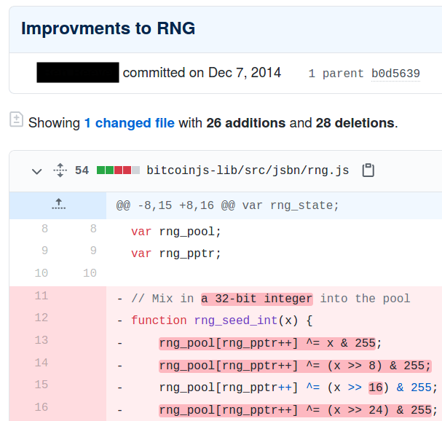
Breaking Bitcoin Wallets
What happens if we use a poor source of entropy?
Bitcoin users use a randomly-generated private key to access their account (and money)
An attacker who learns the key can access the money
We’ll learn more about Bitcoin later
An “improvment” [sic] to the algorithm reduced the entropy used to generate the private keys
Any private key created with this “improvment” could be brute-forced

Slide 11
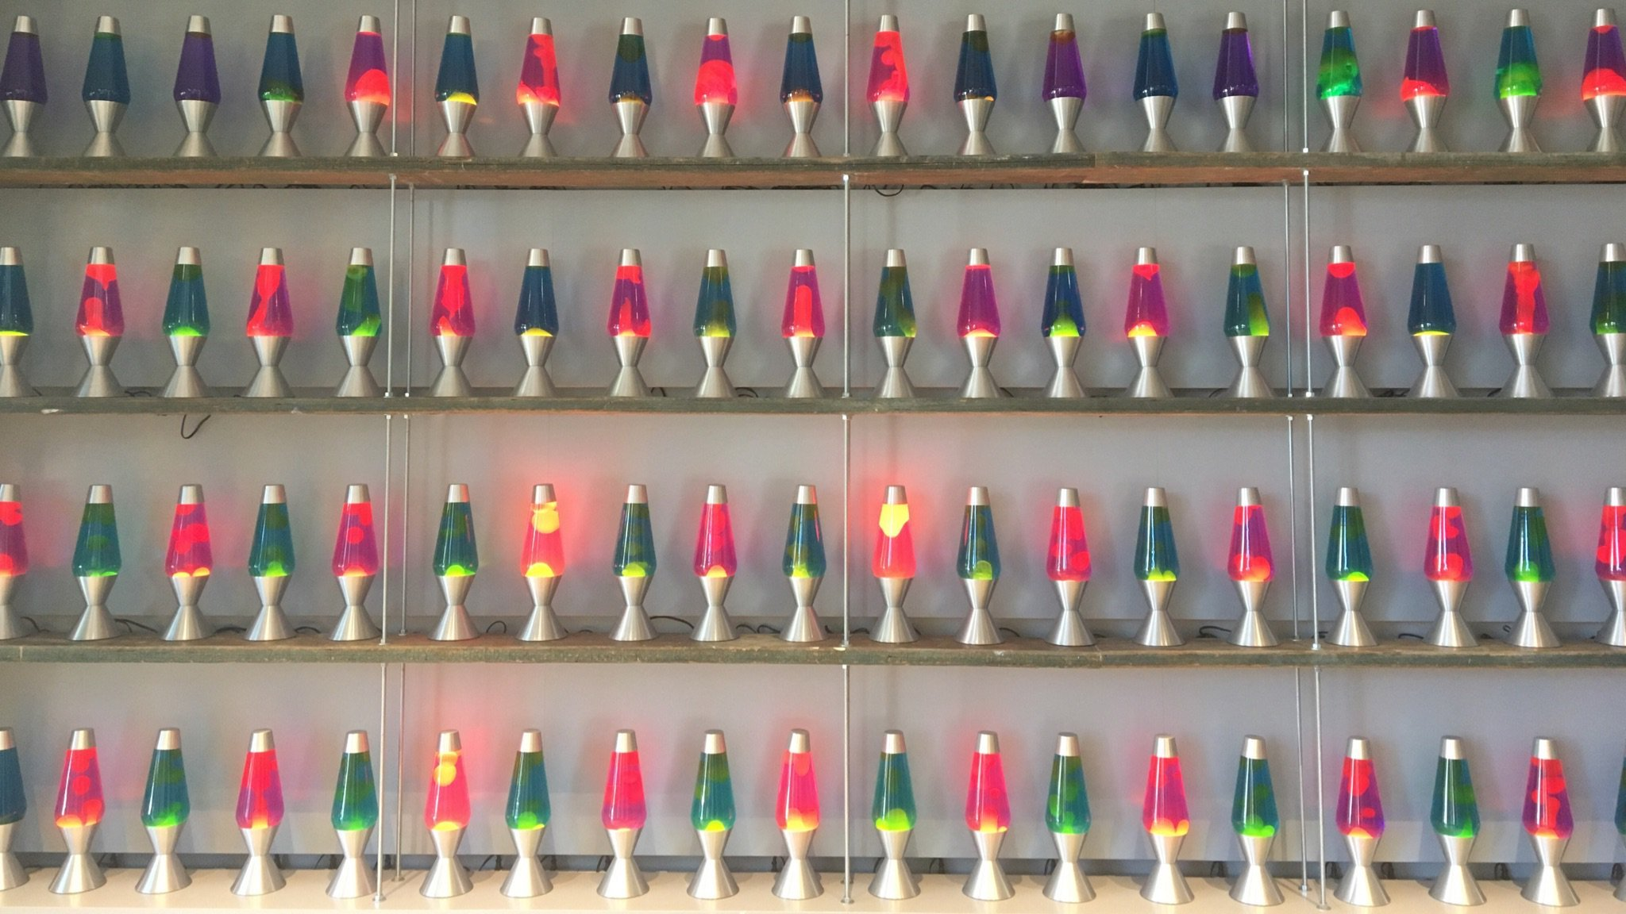
True Randomness
To generate truly random numbers, we need a physical source of entropy
Lava lamps
Earthquake strength or interval
An unpredictable circuit on a CPU
Human activity measured at very fine time scales (e.g. the microsecond you pressed a key)
Issues with true randomness
It’s expensive and slow to generate
Physical entropy sources are often biased
Exotic entropy source: Cloudflare has a wall of lava lamps that are recorded by an HD video camera that views the lamps through a rotating prism
Notes:
LavaRand is a system that uses lava lamps as a secondary source of randomness for our production servers. A wall of lava lamps in the lobby of our San Francisco office provides an unpredictable input to a camera aimed at the wall. A video feed from the camera is fed into a CSPRNG, and that CSPRNG provides a stream of random values that can be used as an extra source of randomness by our production servers. Since the flow of the “lava” in a lava lamp is very unpredictable,¹ “measuring” the lamps by taking footage of them is a good way to obtain unpredictable randomness. Computers store images as very large numbers, so we can use them as the input to a CSPRNG just like any other number.
The "real world" turns out to be a great source for randomness, because events in the physical world are unpredictable. As one might expect, lava lamps are consistently random. The "lava" in a lava lamp never takes the same shape twice, and as a result, observing a group of lava lamps is a great source for random data.
Randomness bias is the natural tendency to see patterns in random data. A simple example that everyone is familiar with is children seeing various pictures in clouds. This cloud looks like the profile of a person’s face, that one looks like a dog, etc. But really the shapes of the clouds are partially random.

Slide 12
Pseudorandom Number Generators (PRNGs)
True randomness is expensive and biased
Pseudorandom number generator (PRNGs): An algorithm that uses a little bit of true randomness to generate a lot of random-looking output
Also called deterministic random bit generators (DRBGs)
Usage
Generate some expensive true randomness (e.g. noisy circuit on your CPU)
Use the true randomness as input to the PRNG
Generate random-looking numbers quickly and cheaply with the PRNG
PRNGs are deterministic: Output is generated according to a set algorithm
However, for an attacker who can’t see the internal state, the output is computationally indistinguishable from true randomness

Slide 13
PRNG: Definition
A PRNG has three functions:
PRNG.Seed(randomness): Initializes the internal state using the entropy
Input: Some truly random bits
PRNG.Reseed(randomness): Updates the internal state using the existing state and the entropy
Input: More truly random bits
PRNG.Generate(n): Generate n pseudorandom bits
Input: A number n
Output: n pseudorandom bits
Updates the internal state as needed
Properties
Correctness: Deterministic
Efficiency: Efficient to generate pseudorandom bits
Security: Indistinguishability from random
Additional security: Rollback resistance

Slide 14
PRNG: Seeding and Reseeding
Recall: Number of bits of entropy should be the sum of the number of bits in all sources
A PRNG should be seeded with all available sources of entropy
Combining many low-entropy sources should result in high-entropy output
If one source has 0 entropy, it should not reduce the entropy of the output
Reseeding is used to add even more entropy as it becomes available
Reseeding with 0 entropy should not reduce the entropy of the internal state or output

Slide 15
PRNG: Security
Can we design a PRNG that is truly random?
A PRNG cannot be truly random
The output is deterministic given the initial seed
If the initial seed is s bits long, there are only 2^{s} possible output sequences
A secure PRNG is computationally indistinguishable from random to an attacker
Game: Present an attacker with a truly random sequence and a sequence outputted from a secure PRNG
An attacker should not be able to determine which is which with probability > 1/2 + negligible
Equivalent definition: An attacker cannot predict future output of the PRNG

Slide 16
Insecure PRNGs: Breaking Slot Machines
What happens if PRNGs are used improperly?
A casino in St. Louis experienced unusual bad “luck”
Suspicious players would hover over the lever and then spin at a specific time to win
Vulnerability: Slot machines used predictable PRNGs
The PRNG output was based on the current time
Strategy:
Use a smartphone to alert you to when to pull the lever for the best chance of winning
Las Vegas was not affected by the vulnerability
Nevada slot machines must follow evaluation standards designed to address this sort of issue
Notes:
https://www.wired.com/2017/02/russians-engineer-brilliant-slot-machine-cheat-casinos-no-fix/

Slide 17
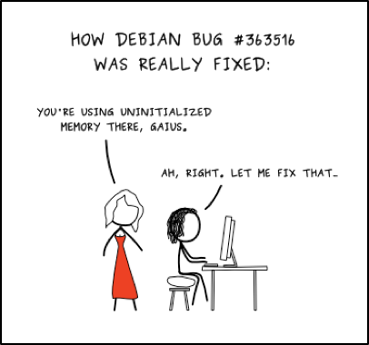
Insecure PRNGs: OpenSSL PRNG bug
What happens if we don’t use enough entropy?
Debian OpenSSL CVE-2008-0166
Debian: A Linux distribution
OpenSSL: A cryptographic library
In “cleaning up” OpenSSL (Debian “bug” #363516), the author “fixed” how OpenSSL seeds random numbers
The existing code caused Purify and Valgrind to complain about reading uninitialized memory
The cleanup caused the PRNG to only be seeded with the process ID
There are only 2¹⁵ (32,768) possible process IDs, so the PRNG only has 15 bits of entropy
Easy to deduce private keys generated with the PRNG
Set the PRNG to every possible starting state and generate a few private/public key pairs
See if the matching public key is anywhere on the Internet
Notes:
http://blog.dieweltistgarnichtso.net/Caprica,-2-years-ago

Slide 18
PRNG: Rollback Resistance
Rollback resistance: If the attacker learns the internal PRNG state, they cannot learn anything about previous states or outputs
Game: An attacker knows the current internal state of the PRNG and is given a sequence of truly random bits and a sequence of previous output from the PRNG
The attacker cannot determine which is which with probability > 1/2
Rollback resistance is not required in a secure PRNG, but it is a useful property
Consider:
Alice uses the same PRNG to generate her secret key and the IVs for encryption
Mallory compromises the internal state of the PRNG
If the PRNG is not rollback resistant, Mallory can derive previous PRNG output… such as the secret key
Notes:
"...but it should be" ~Nick Weaver

Slide 19
HMAC-DRBG
Idea: HMAC output looks unpredictable. Let’s use HMAC to build a PRNG!
HMAC takes two arguments (key and message). Let’s keep two values, K (key) and V (value) as internal state
Notes:
Deterministic Random Bit Generator (DRBG)

Slide 20
HMAC-DRBG
Seed(s):
K = 0
V = 0
K = HMAC(K, V || 0x00 || s)
V = HMAC(K, V)
K = HMAC(K, V || 0x01 || s)
V = HMAC(K, V)
Initialize internal state
Update internal state with provided entropy

Slide 21
HMAC-DRBG
Reseed(s):
K = HMAC(K, V || 0x00 || s)
V = HMAC(K, V)
K = HMAC(K, V || 0x01 || s)
V = HMAC(K, V)
Update internal state with provided entropy

Slide 22
HMAC-DRBG
Generate(n):
output = ''
while len(output) < n do
V = HMAC(K, V)
output = output || V
end while
K = HMAC(K, V || 0x00)
V = HMAC(K, V)
return output[:n]
Call HMAC repeatedly to generate random-looking output
Update internal state with no extra entropy
Notes:
Notice: 1 HMAC call per block of bits plus 2 HMAC calls per call to Generate

Slide 23
HMAC-DRBG: Security
Assuming HMAC is secure, HMAC-DRBG is a secure, rollback-resistant PRNG
Secure: If you can distinguish PRNG output from random, then you’ve distinguished HMAC from random
Rollback-resistant: If you can derive old output from the current state, then you’ve reversed the hash function or HMAC
The full proof is out of scope
In other words: if you break HMAC-DRBG, you’ve either broken HMAC or the underlying hash function
Notes:
"HMAC-DRBG is the best PRNG construction: accept no substitutes!" ~Nick Weaver [TODO Nick]

Slide 24
Insecure PRNGs: CVE-2019-16303
Relevant if you wrote an app in JHipster before 2019
Password reset functions
When you forget your password, receive an email with a special link to reset your password
The special link should contain a randomly-generated code (so attackers can't make their own link)
Vulnerability: Bad PRNG
You can figure out the PRNG’s internal state from the reset link
Request password reset links for other people's accounts
Predict the “random” reset link and take over any account you want!

Slide 25
Insecure PRNGs: Rust Rand_Core
A Rust library has an interface for “secure” random number generators… but it isn’t actually secure!
Example: ChaCha8Rng
A stream cipher PRNG
No reseed function: no way of adding extra entropy after the initial seed
Seed only takes 32 bits: no way to combine entropy
No rollback resistance
None of the “secure” RNGs are cryptographically secure
None have a reseed function to add extra entropy
None take arbitrarily long seeds
Takeaway: Always make sure you use a secure PRNG
Consider human factors? Use fail-safe defaults?
Notes:
Nick got in a Twitter fight over this (2020)
https://twitter.com/ncweaver/status/1308178039755350018

Slide 26
Application: Universally Unique Identifiers (UUIDs)
Scenario
You have a set of objects (e.g. files)
You need to assign a unique name to every object
Every name must be unique and unpredictable
Solution: Choose a random value
If you use enough randomness, the probability of generating the same random value twice are astronomically small (basically 0)
Universally Unique Identifiers (UUIDs)
128-bit unique values
To generate a new UUID, seed a secure PRNG properly, and generate a random value
Often written in hexadecimal: 00112233-4455-6677-8899-aabbccddeeff

Slide 27
PRNGs: Summary
True randomness requires sampling a physical process
Slow, expensive, and biased (low entropy)
PRNG: An algorithm that uses a little bit of true randomness to generate a lot of random-looking output
Seed(entropy): Initialize internal state
Reseed(entropy): Add additional entropy to the internal state
Generate(n): Generate n bits of pseudorandom output
Security: Computationally indistinguishable from truly random bits
CTR-DRBG: Use a block cipher in CTR mode to generate pseudorandom bits
HMAC-DRBG: Use repeated applications of HMAC to generate pseudorandom bits
Application: UUIDs

Slide 28
Stream Ciphers

Slide 29
Stream Ciphers
Another way to construct symmetric key encryption schemes
Idea
A secure PRNG produces output that looks indistinguishable from random
An attacker who can’t see the internal PRNG state can’t learn any output
What if we used PRNG output as the key to a one-time pad?
Stream cipher: A symmetric encryption algorithm that uses pseudorandom bits as the key to a one-time pad

Slide 30
Stream Ciphers
Protocol: Alice and Bob both seed a secure PRNG with their symmetric secret key, and then use the output as the key for a one-time pad
Alice
Bob
Seed(k)
Seed(k)
Generate(n)
Generate(n)
Plaintext
⊕
Ciphertext
⊕
Plaintext
Notes:
TODO Let’s make the K’s capitalized at some point

Slide 31
Stream Ciphers: Encrypting Multiple Messages
Recall: One-time pads are insecure when the key is reused. How do we encrypt multiple messages without key reuse?
Alice
Bob
Seed(k)
Seed(k)
Generate(n)
Generate(n)
Plaintext
⊕
Ciphertext
⊕
Plaintext

Slide 32
Stream Ciphers: Encrypting Multiple Messages
Solution: For each message, seed the PRNG with the key and a random IV, concatenated. Send the IV with the ciphertext
Alice
Bob
IV
IV
Seed(k || IV)
Seed(k || IV)
Generate(n)
Generate(n)
Plaintext
⊕
Ciphertext
⊕
Plaintext
Notes:
TODO Concatenation should probably be ||, not |.

Slide 33
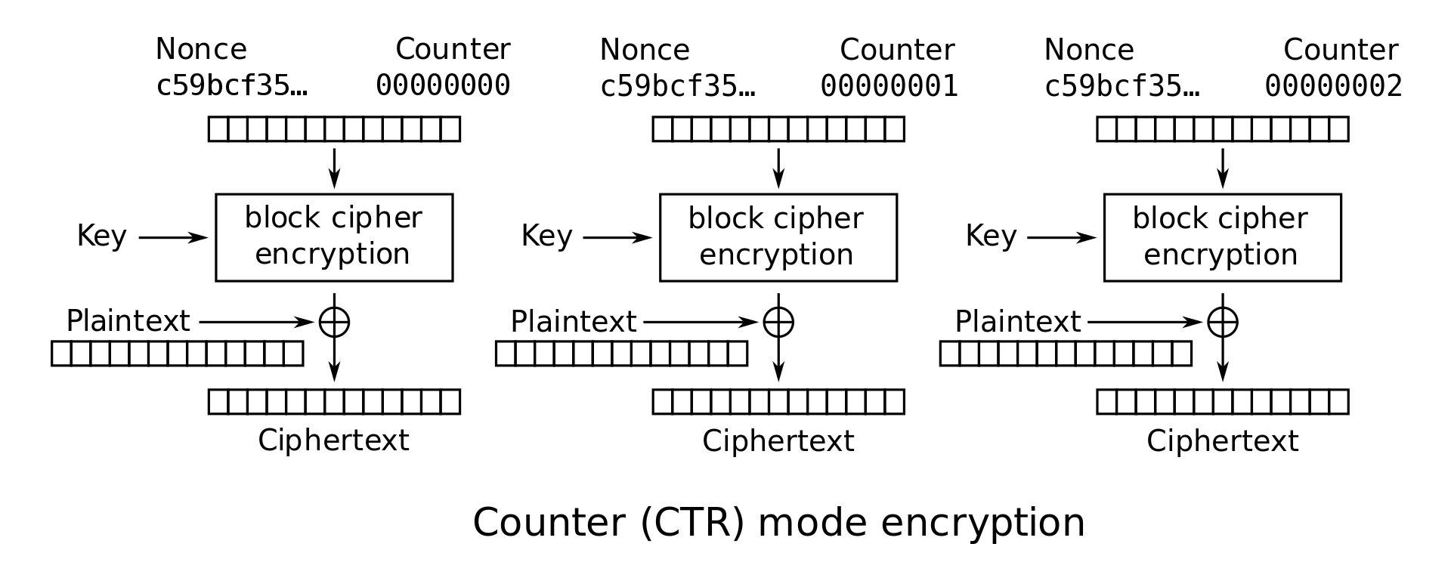
Stream Ciphers: AES-CTR
If you squint carefully, AES-CTR is a type of stream cipher
Output of the block ciphers is pseudorandom and used as a one-time pad

Slide 34
Stream Ciphers: Security
Stream ciphers are IND-CPA secure, assuming the pseudorandom output is secure
In some stream ciphers, security is compromised if too much plaintext is encrypted
Example: In AES-CTR, if you encrypt so many blocks that the counter wraps around, you’ll start reusing keys
In practice, if the key is n bits long, usually stop after 2^{n/2} bits of output
Example: In AES-CTR with 128-bit counters, stop after 2⁶⁴ blocks of output

Slide 35
Stream Ciphers: Encryption Efficiency
Stream ciphers can continually process new elements as they arrive
Only need to maintain internal state of the PRNG
Keep generating more PRNG output as more input arrives
Compare to block ciphers: Need modes of operations to handle longer messages, and modes like AES-CBC need padding to function, so doesn’t function well on streams
Notes:
Anyone who actually calls this a "One Time Pad" is selling snake oil!

Slide 36
Stream Ciphers: Decryption Efficiency
Suppose you received a 1 GB ciphertext (encryption of a 1 GB message) and you only wanted to decrypt the last 128 bytes
Benefit of some stream ciphers: You can decrypt one part of the ciphertext without decrypting the entire ciphertext
Example: In AES-CTR, to decrypt only block i, compute EK(nonce || i) and XOR with the ith block of ciphertext
Example: ChaCha20 (another stream cipher) lets you decrypt arbitrary parts of ciphertext
What about HMAC-DRBG? You have to generate all the PRNG output up until the block you want to decrypt

Slide 37
Next: Diffie-Hellman Key Exchange
When discussing symmetric-key schemes, we assumed Alice and Bob managed to share a secret key. How can Alice and Bob share a symmetric key over an insecure channel?

Slide 38
Diffie-Hellman Key Exchange

Slide 39
Cryptography Roadmap
 | Symmetric-key | Asymmetric-key
Confidentiality | One-time pads Block ciphers with chaining modes (e.g. AES-CBC) | RSA encryption ElGamal encryption
Integrity, Authentication | MACs (e.g. HMAC) | Digital signatures (e.g. RSA signatures)
Hash functions
Pseudorandom number generators
Public key exchange (e.g. Diffie-Hellman)
Key management (certificates)
Password management

Slide 40
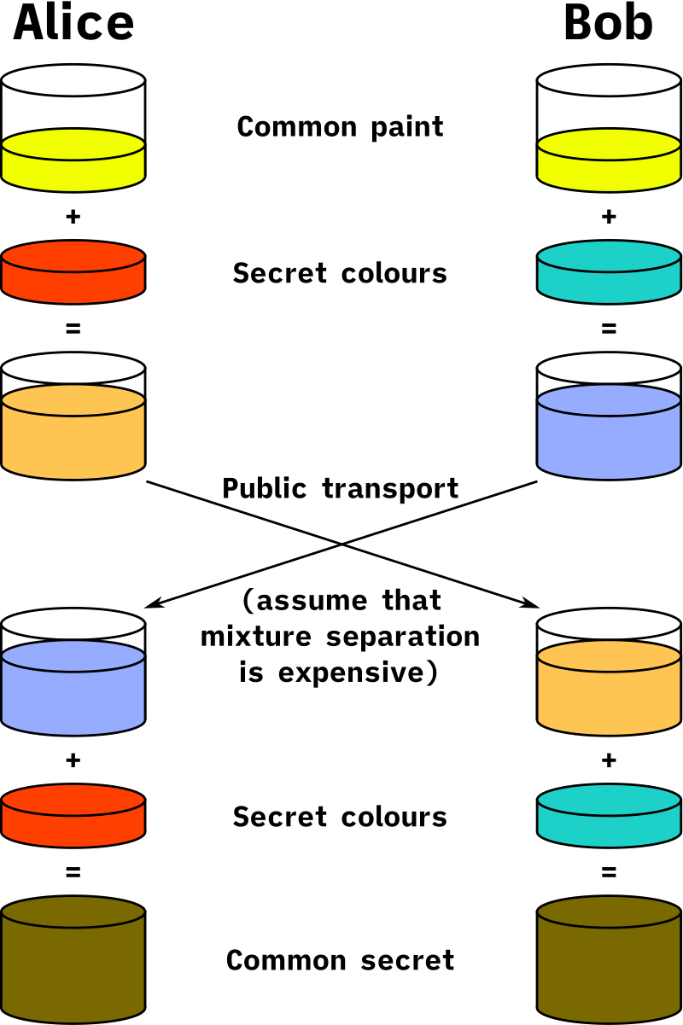
Secure Color Sharing

Slide 41

Secure Color Sharing
Suppose Alice and Bob want a secret paint color, but Eve can see paint colors sent between Alice and Bob
Alice generates a secret color amber A, and Bob generates a secret color blue B
Alice and Bob agree on a common, public color green G
They both mix their secret colors with G, so Alice has green-amber GA, and Bob has green-blue GB
Alice sends GA to Bob, and Bob sends GB to Alice
Note: Eve now knows the colors GA and GB! Assume that it is hard to separate colors.
Alice knows GB, so she can mix in A to form green-amber-blue GAB. Bob knows GA, so he can mix in B to form GAB, as well!
Eve only knows G, GA, and GB, so she can only form green-amber-green-blue GAGB, which is not the same!

Slide 42
Discrete Log Problem and Diffie-Hellman Problem
Recall our paint assumption: Separating a paint mixture is hard
Is there a mathematical version of this? Yes!
Assume everyone knows a large prime p (e.g. 2048 bits long) and a generator g
Don’t worry about what a generator is
Discrete logarithm problem (discrete log problem): Given g, p, gª mod p for random a, it is computationally hard to find a
Diffie-Hellman assumption: Given g, p, gª mod p, and g^{b} mod p for random a, b, no polynomial time attacker can distinguish between a random value R and g^{ab} mod p.
Intuition: The best known algorithm is to first calculate a and then compute (g^{b})ª mod p, but this requires solving the discrete log problem, which is hard!
Note: Multiplying the values doesn’t work, since you get g^{a+b} mod p ≠ g^{ab} mod p

Slide 43
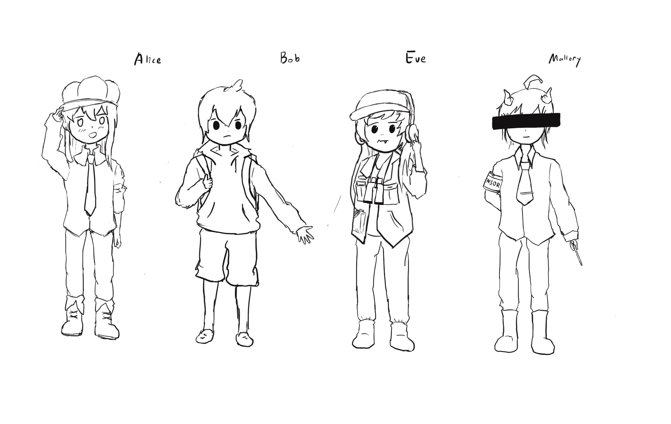
Diffie-Hellman Key Exchange
Public: g, p
Alice
Mallory
Eve
Bob
Secret key
Generate a
Calculate gª mod p
Receive g^{b} mod p
Calculate (g^{b})ª mod p
Generate b
Calculate g^{b} mod p
Receive gª mod p
Calculate (gª)^{b} mod p
gª
g^{b}
Public key
a, gª, g^{b} ⇒ g^{ab}
gª, g^{b} ⇒ g^{ab}
b, gª, g^{b} ⇒ g^{ab}
Shared symmetric key is g^{ab}

Slide 44
Ephemerality of Diffie-Hellman
Diffie-Hellman can be used ephemerally (called Diffie-Hellman ephemeral, or DHE)
Ephemeral: Short-term and temporary, not permanent
Alice and Bob discard a, b, and K = g^{ab} mod p when they’re done
Because you need a and b to derive K, you can never derive K again!
Sometimes K is called a session key, because it’s only used for a an ephemeral session
Benefit of DHE: Forward secrecy
Eve records everything sent over the insecure channel
Alice and Bob use DHE to agree on a key K = g^{ab} mod p
Alice and Bob use K as a symmetric key
After they’re done, discard a, b, and K
Later, Eve steals all of Alice and Bob’s secrets
Eve can’t decrypt any messages she recorded: Nobody saved a, b, or K, and her recording only has gª mod p and g^{b} mod p!

Slide 45
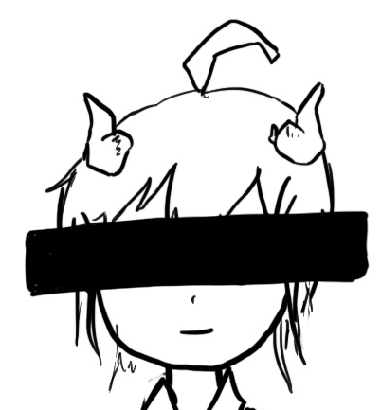
Diffie-Hellman: Security
Alice
Mallory
Public: g, p
Bob
Generate a
Calculate gª mod p
Receive g^{m} mod p
Calculate (g^{m})ª mod p
Generate m
Calculate g^{m} mod p
Generate b
Calculate g^{b} mod p
Receive g^{m} mod p
Calculate (g^{m})^{b} mod p
Receive gª mod p
Calculate (gª)^{m} mod p
Receive g^{b} mod p
Calculate (g^{b})^{m} mod p
a, gª, g^{m} ⇒ g^{am}
m, g^{m}, gª ⇒ g^{am}
m, g^{m}, g^{b} ⇒ g^{bm}
b, g^{b}, g^{m} ⇒ g^{bm}

Slide 46
Diffie-Hellman: Issues
Diffie-Hellman is not secure against a MITM adversary
DHE is an active protocol: Alice and Bob need to be online at the same time to exchange keys
What if Bob wants to encrypt something and send it to Alice for her to read later?
Next time: How do we use public-key encryption to send encrypted messages when Alice and Bob don’t share keys and aren’t online at the same time?
Diffie-Hellman does not provide authentication
You exchanged keys with someone, but Diffie-Hellman makes no guarantees about who you exchanged keys with; it could be Mallory!

Slide 47
Elliptic-Curve Diffie-Hellman (ECDH)
Notice: The discrete-log problem seems hard because exponentiating integers in modular arithmetic “wraps around”
Diffie-Hellman can be generalized to any mathematical group that has this cyclic property
Discrete-log uses the “multiplicative group of integers mod p under generator g”
Elliptic curves: A type of mathematical curve
Big idea: Repeatedly adding a point to itself on a curve is another cyclic group
You don’t need to understand the math behind elliptic curves
Elliptic-curve Diffie-Hellman: A variation of Diffie-Hellman that uses elliptic curves instead of modular arithmetic
Based on the elliptic curve discrete log problem, the analog of the discrete log problem
Benefit of ECDH: The underlying problem is harder to solve, so we can use smaller keys (3072-bit DHE is about as secure as 384-bit ECDHE)

Slide 48
Summary: Diffie-Hellman Key Exchange
Algorithm:
Alice chooses a and sends gª mod p to Bob
Bob chooses b and sends g^{b} mod p to Alice
Their shared secret is (gª)^{b} = (g^{b})ª = g^{ab} mod p
Diffie-Hellman provides forwards secrecy: Nothing is saved or can be recorded that can ever recover the key
Diffie-Hellman can be performed over other mathematical groups, such as elliptic-curve Diffie-Hellman (ECDH)
Issues
Not secure against MITM
Both parties must be online
Does not provide authenticity

